Slide 1
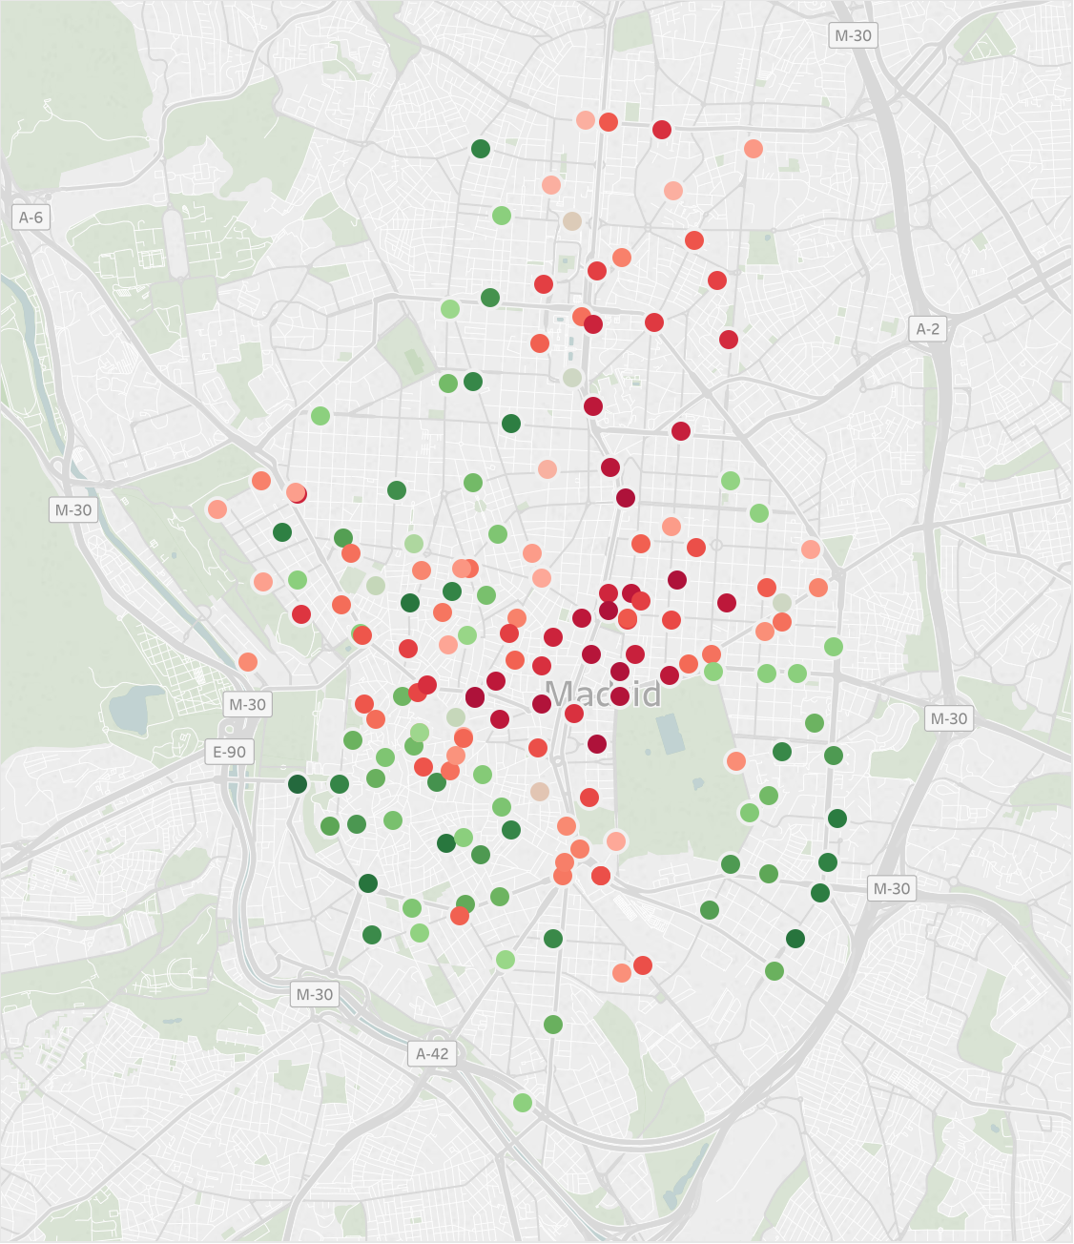
00:00 Tuesday

Slide 2
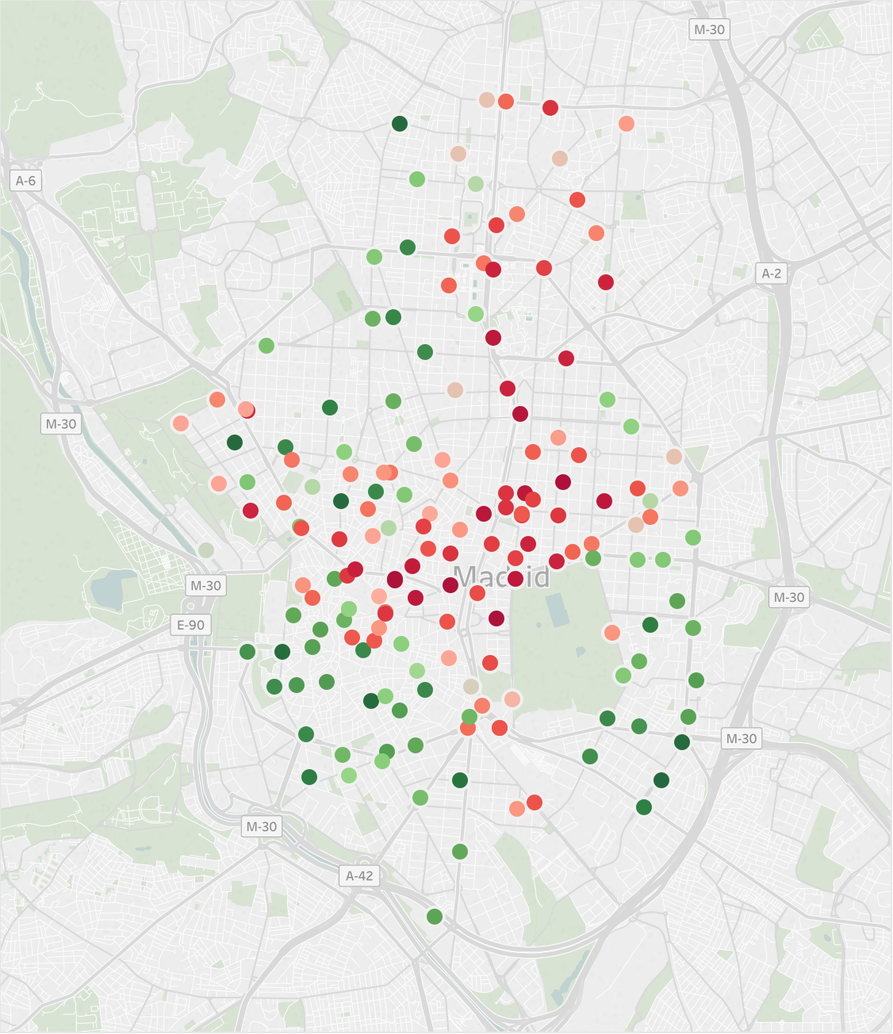
01:00 Tuesday

Slide 3
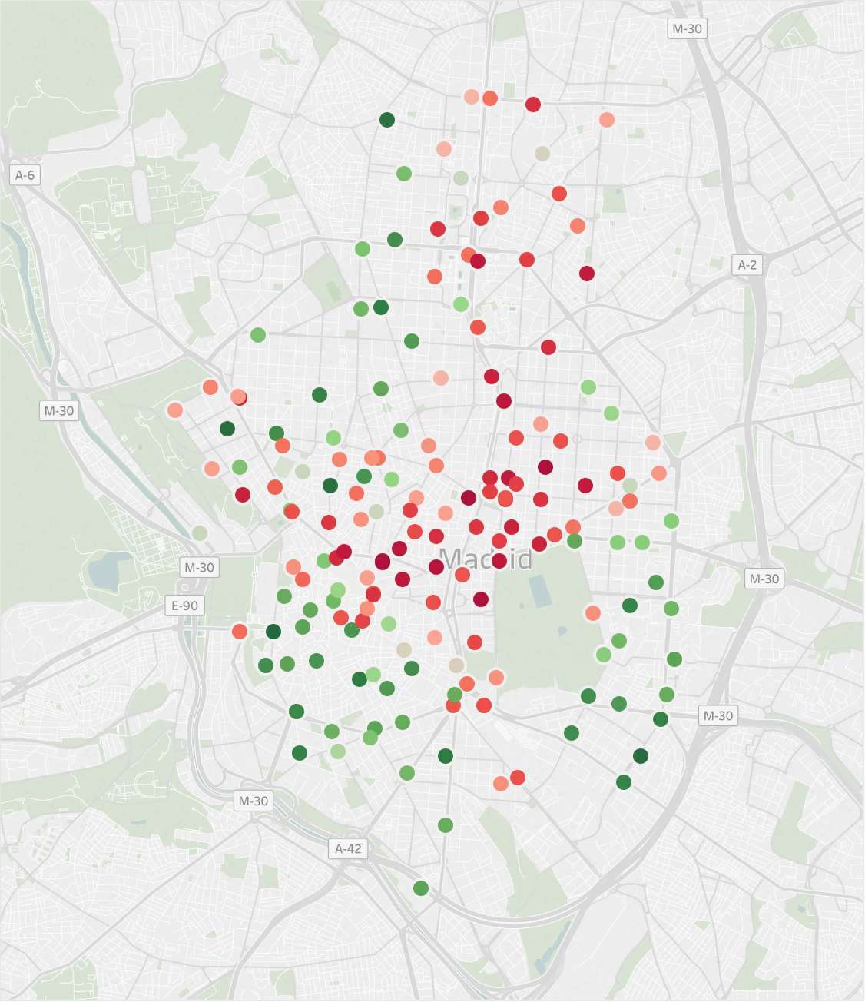
02:00 Tuesday

Slide 4
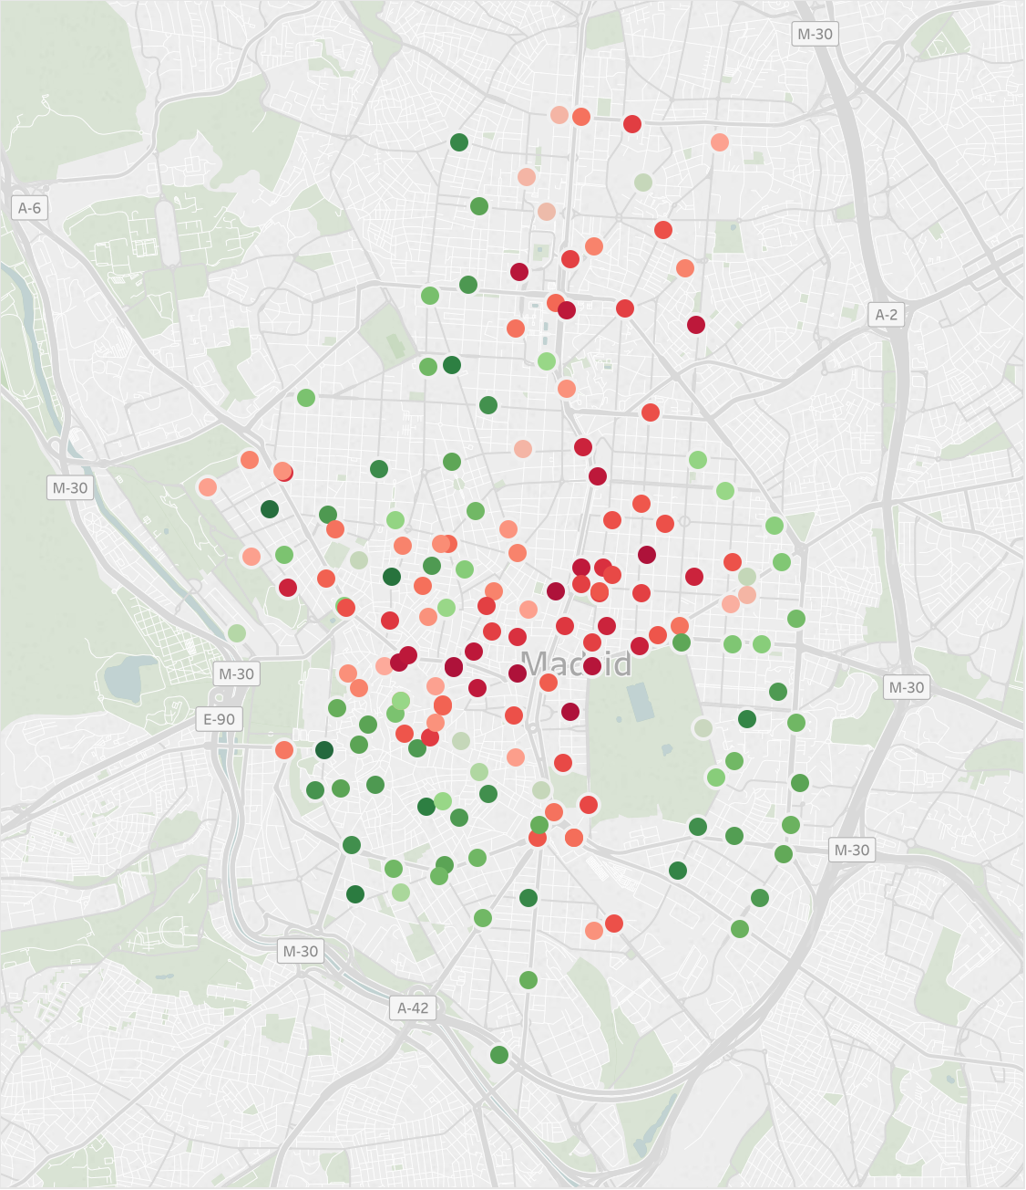
03:00 Tuesday

Slide 5
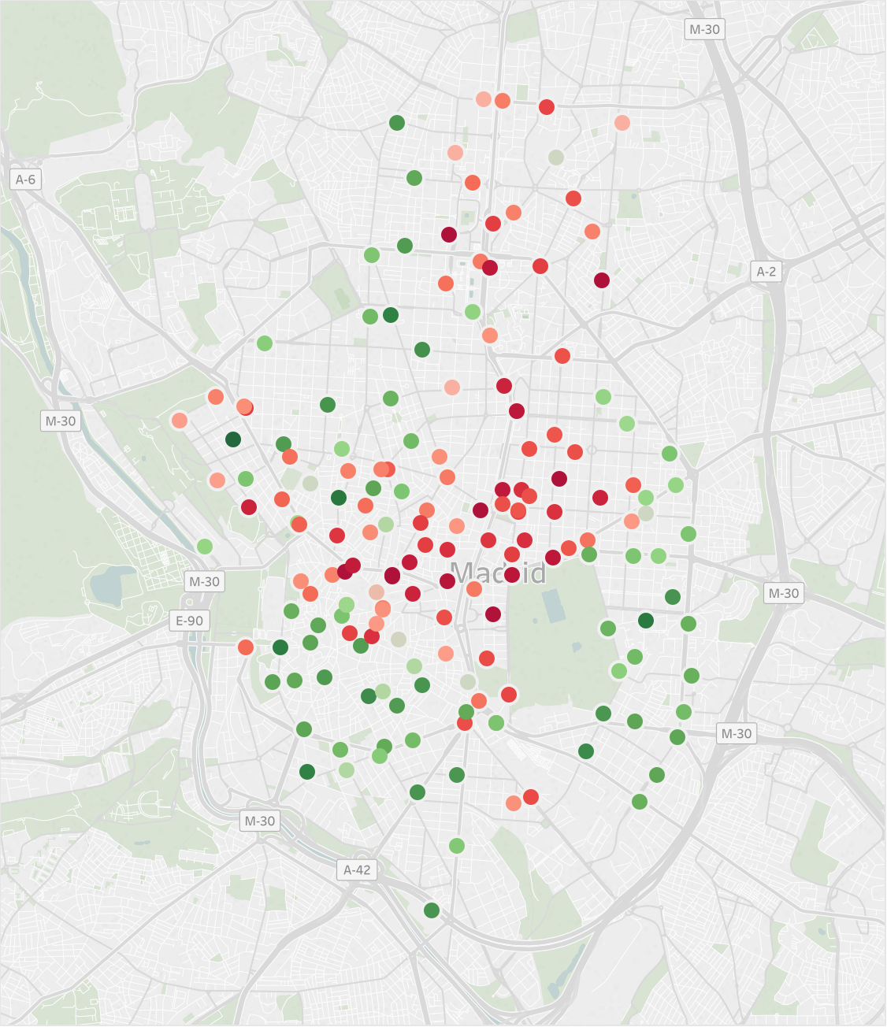
04:00 Tuesday

Slide 6
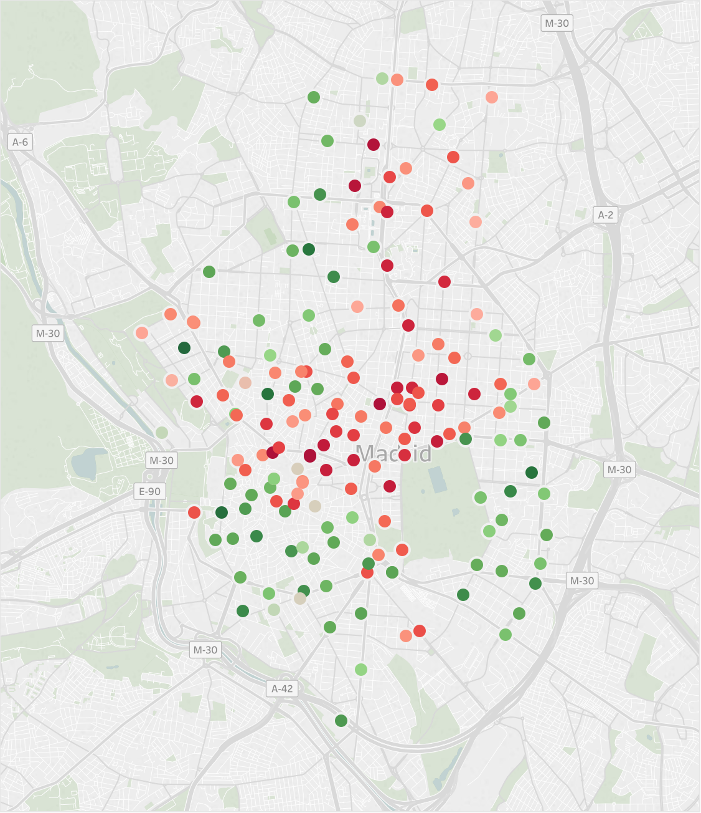
05:00 Tuesday

Slide 7
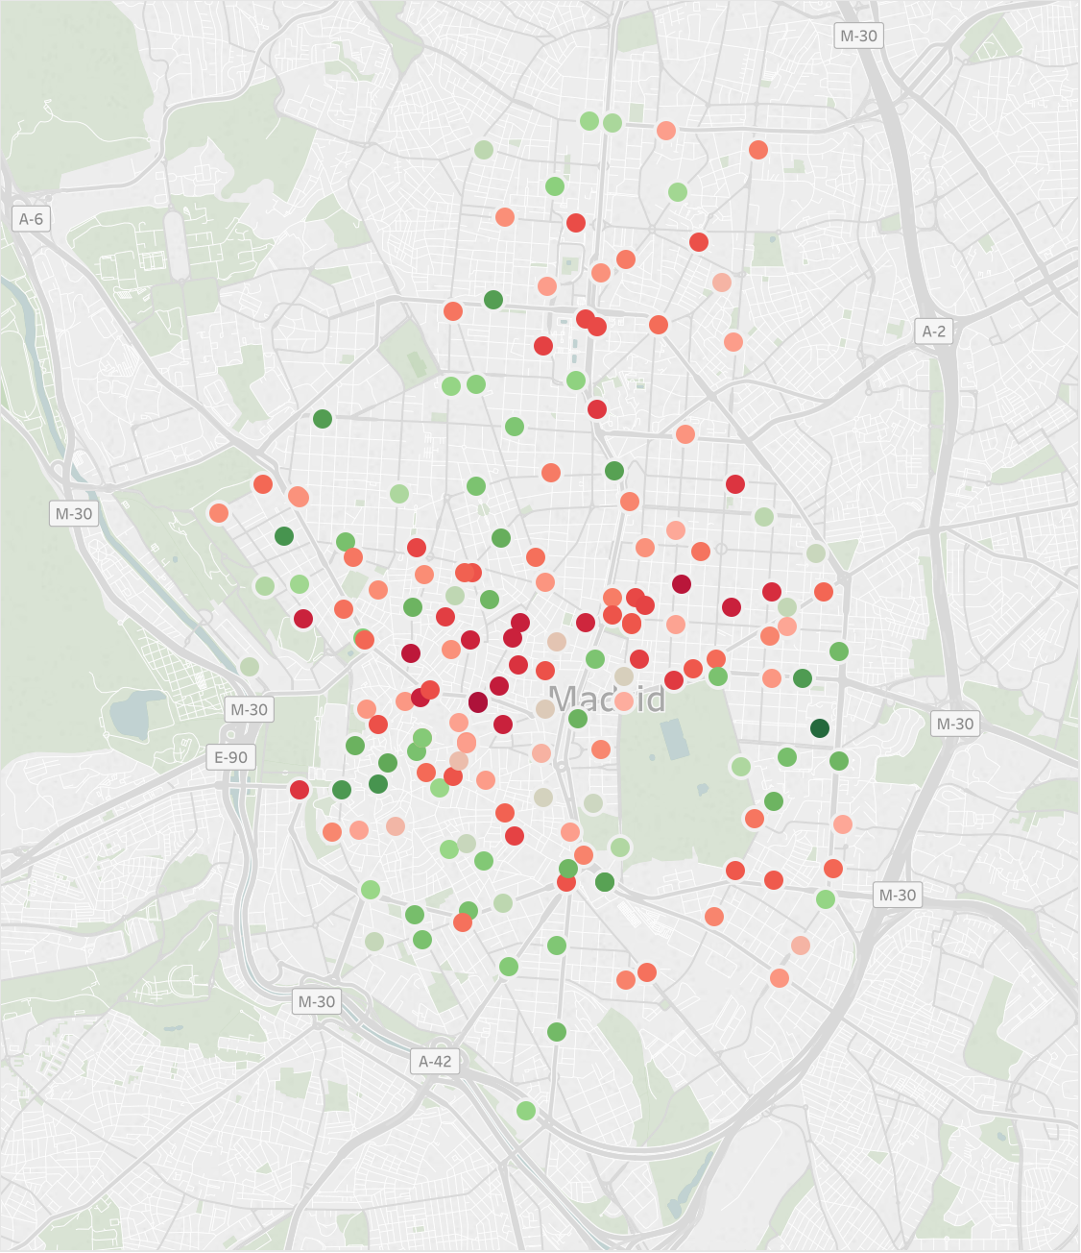
06:00 Tuesday

Slide 8
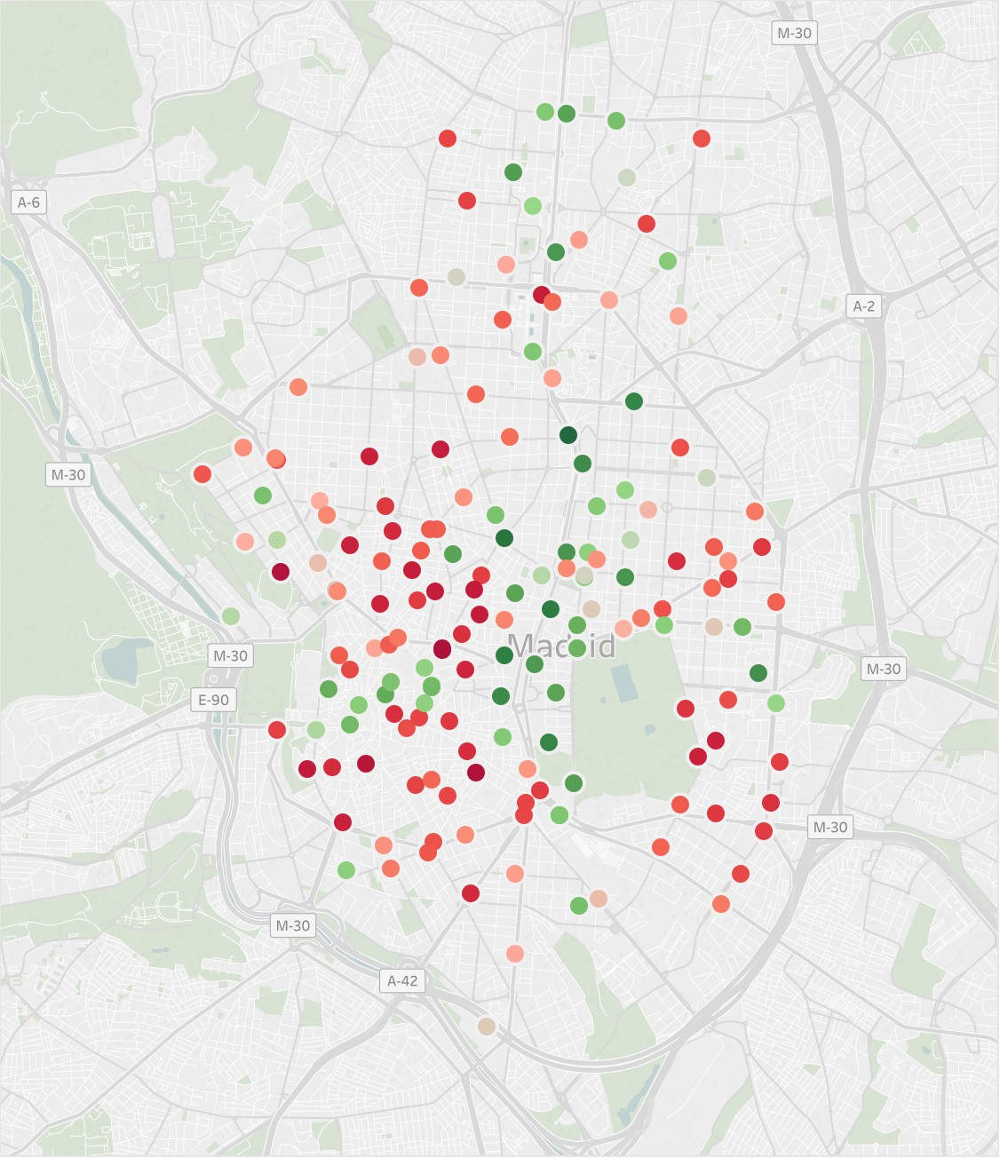
07:00 Tuesday

Slide 9
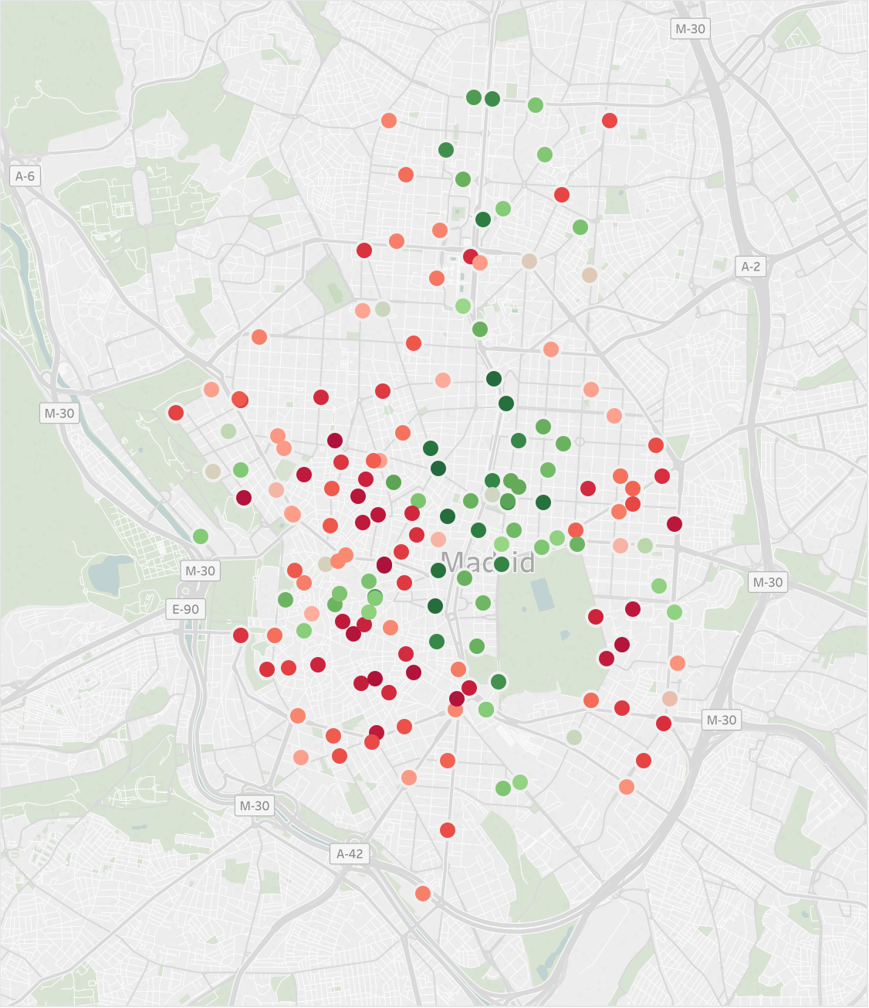
08:00 Tuesday

Slide 10
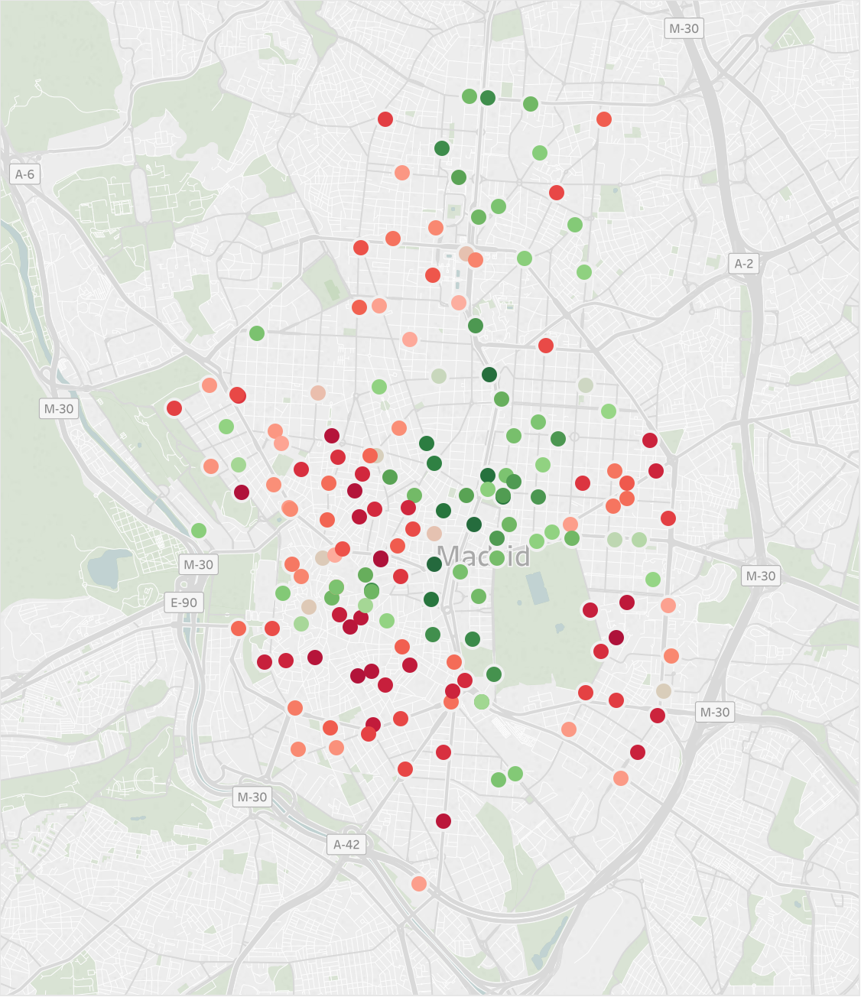
09:00 Tuesday

Slide 11
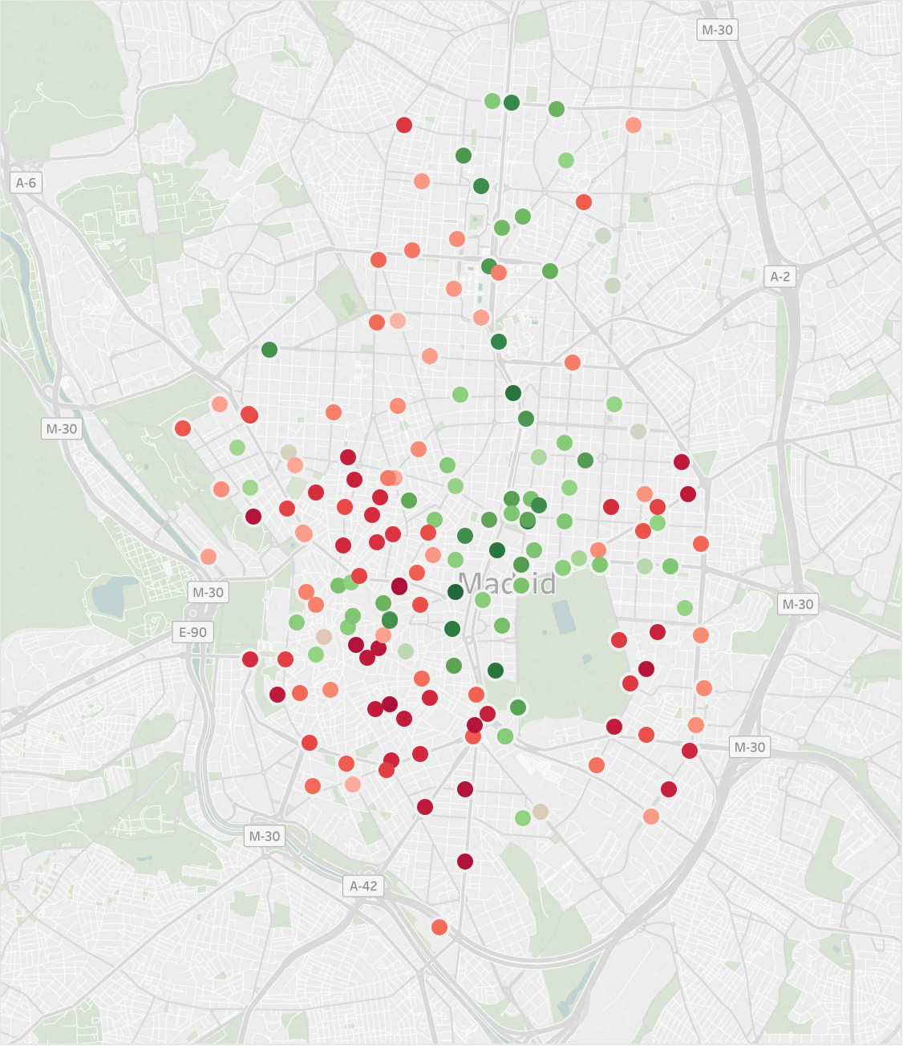
10:00 Tuesday

Slide 12
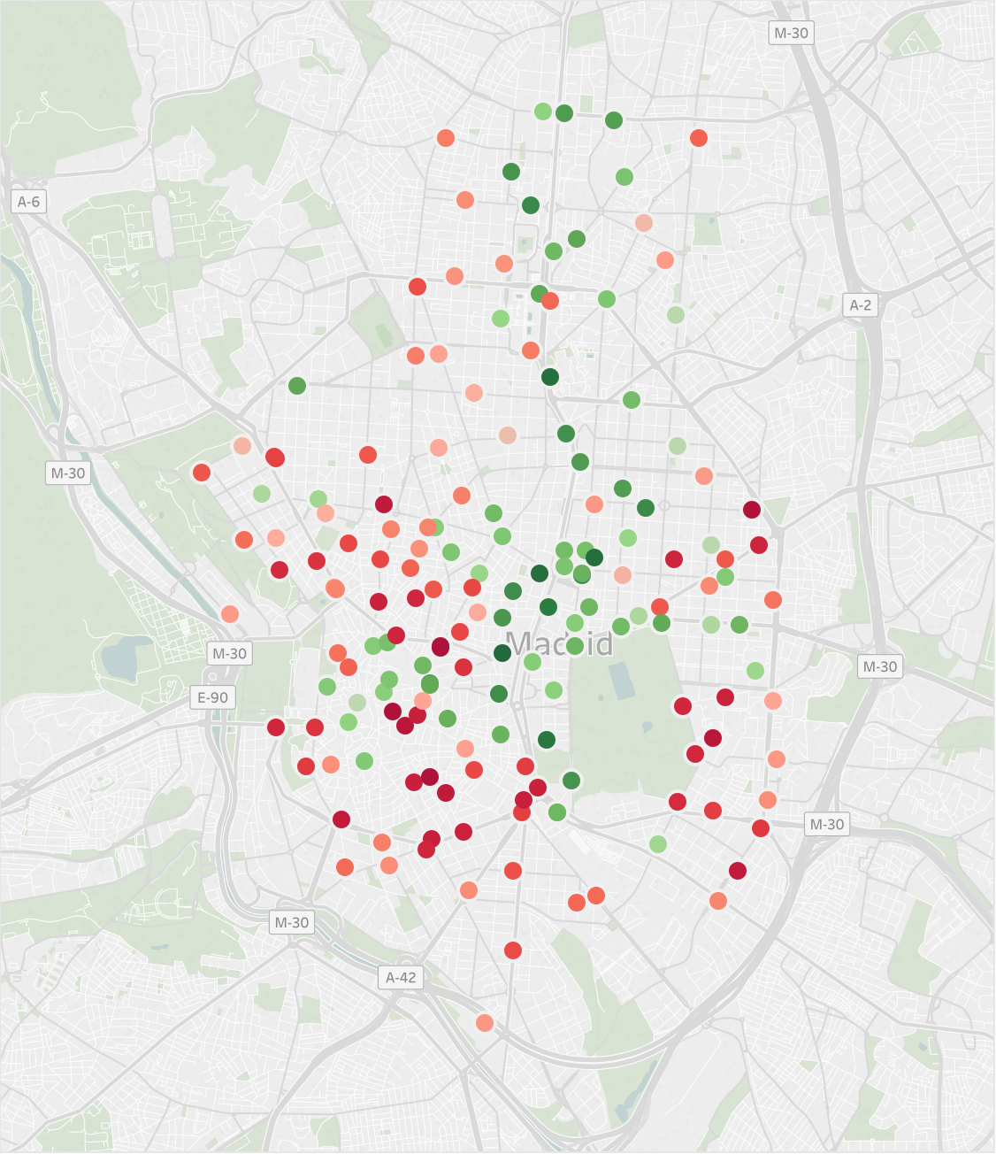
11:00 Tuesday

Slide 13
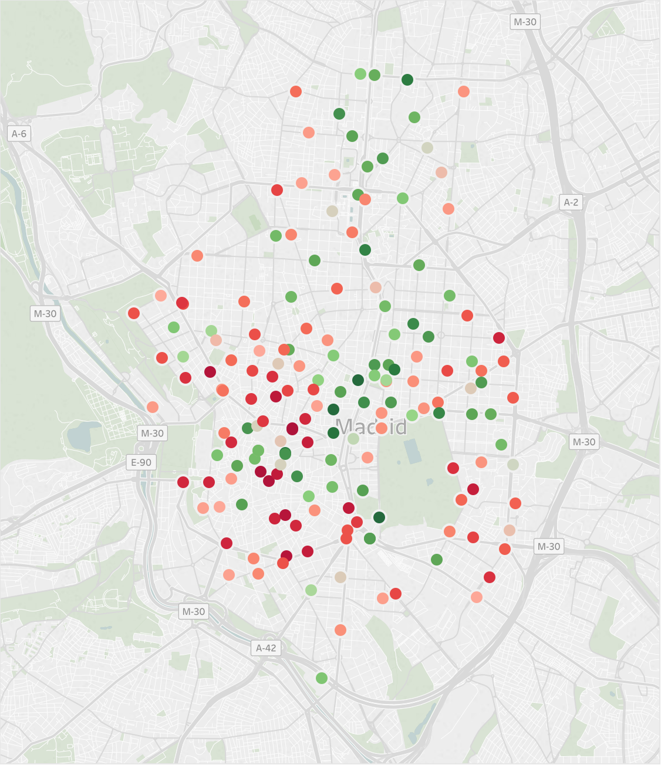
12:00 Tuesday

Slide 14
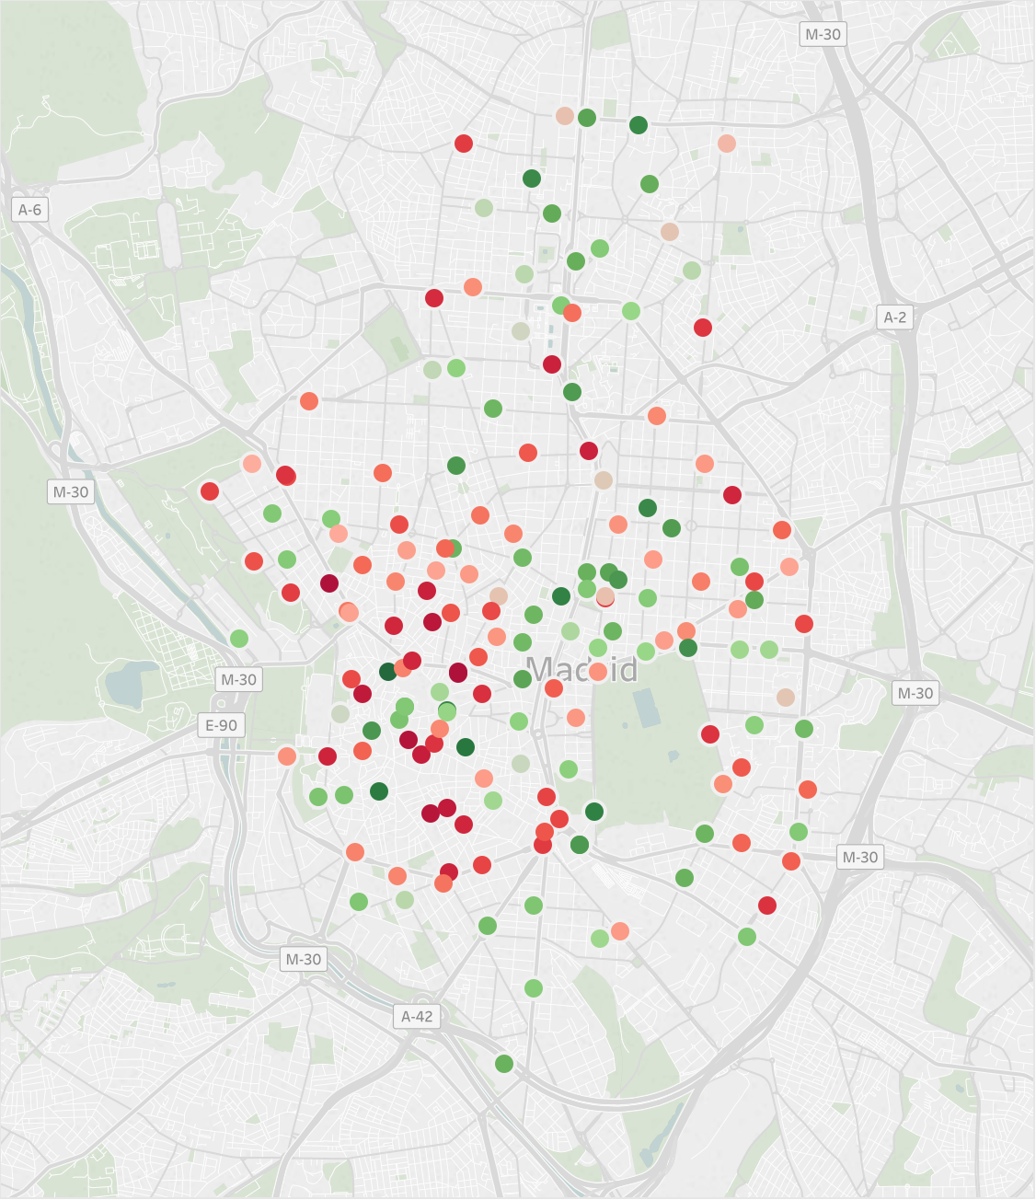
13:00 Tuesday

Slide 15

14:00 Tuesday

Slide 16
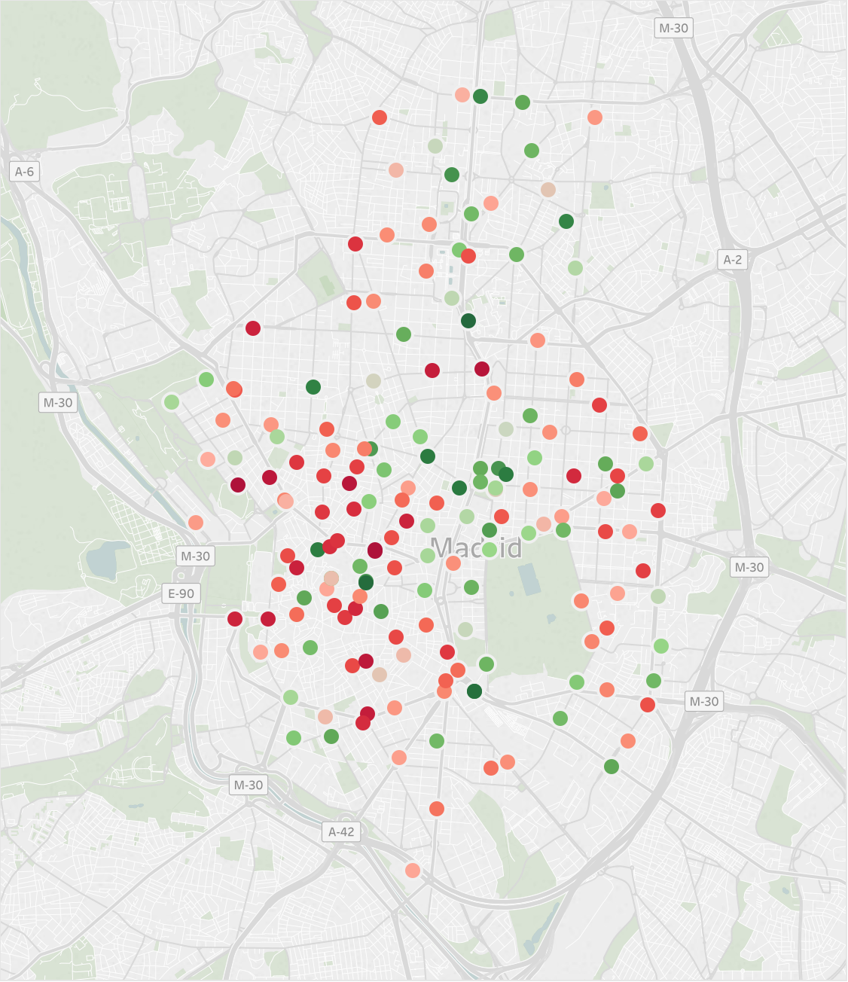
15:00 Tuesday

Slide 17
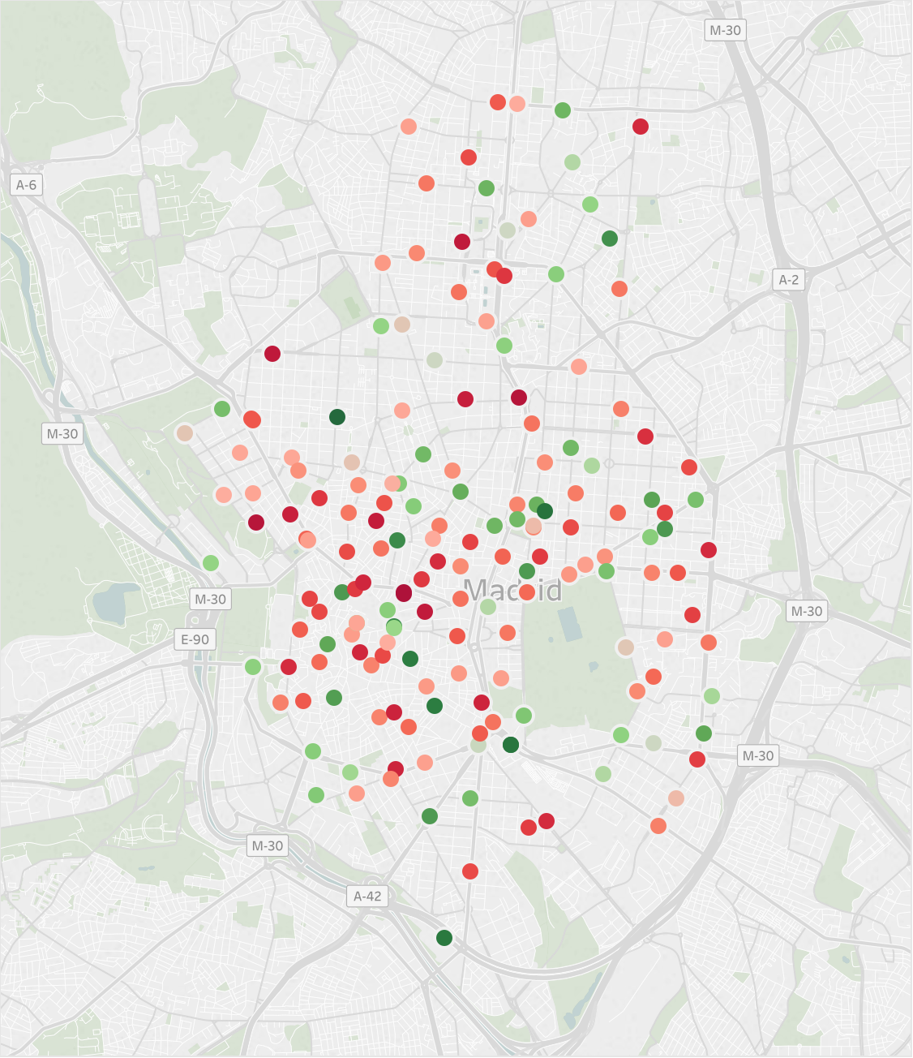
16:00 Tuesday

Slide 18
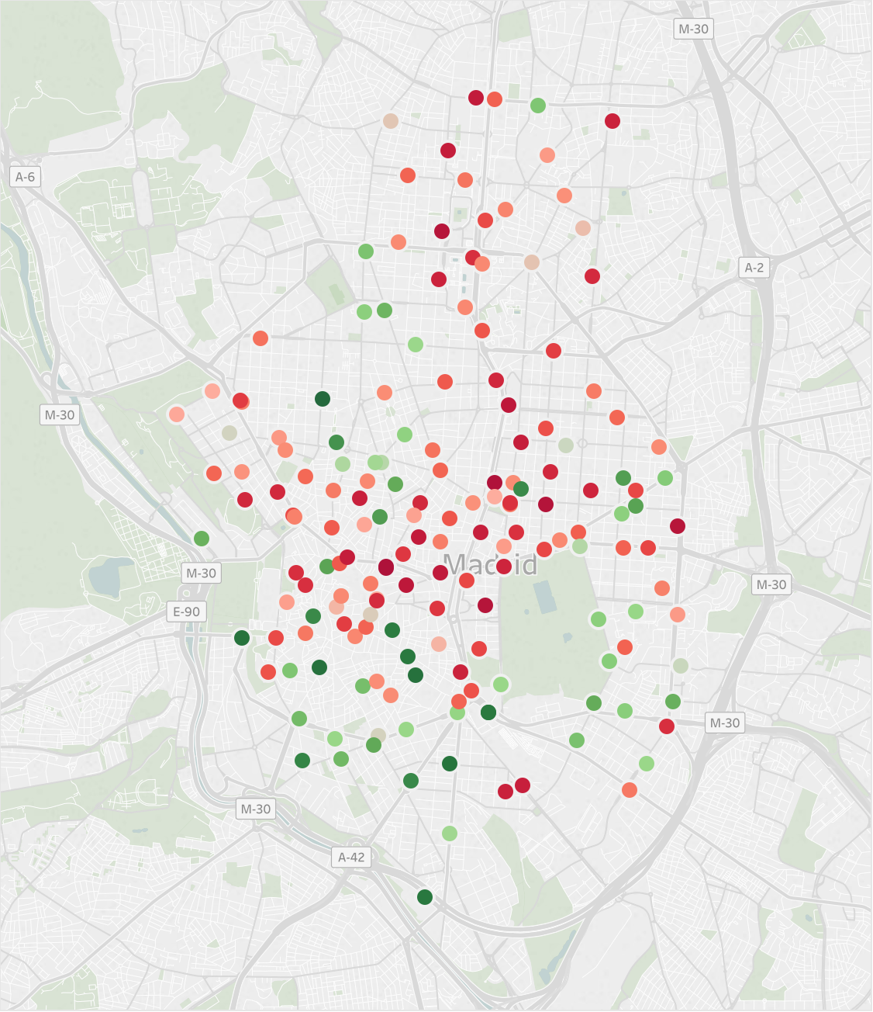
17:00 Tuesday

Slide 19
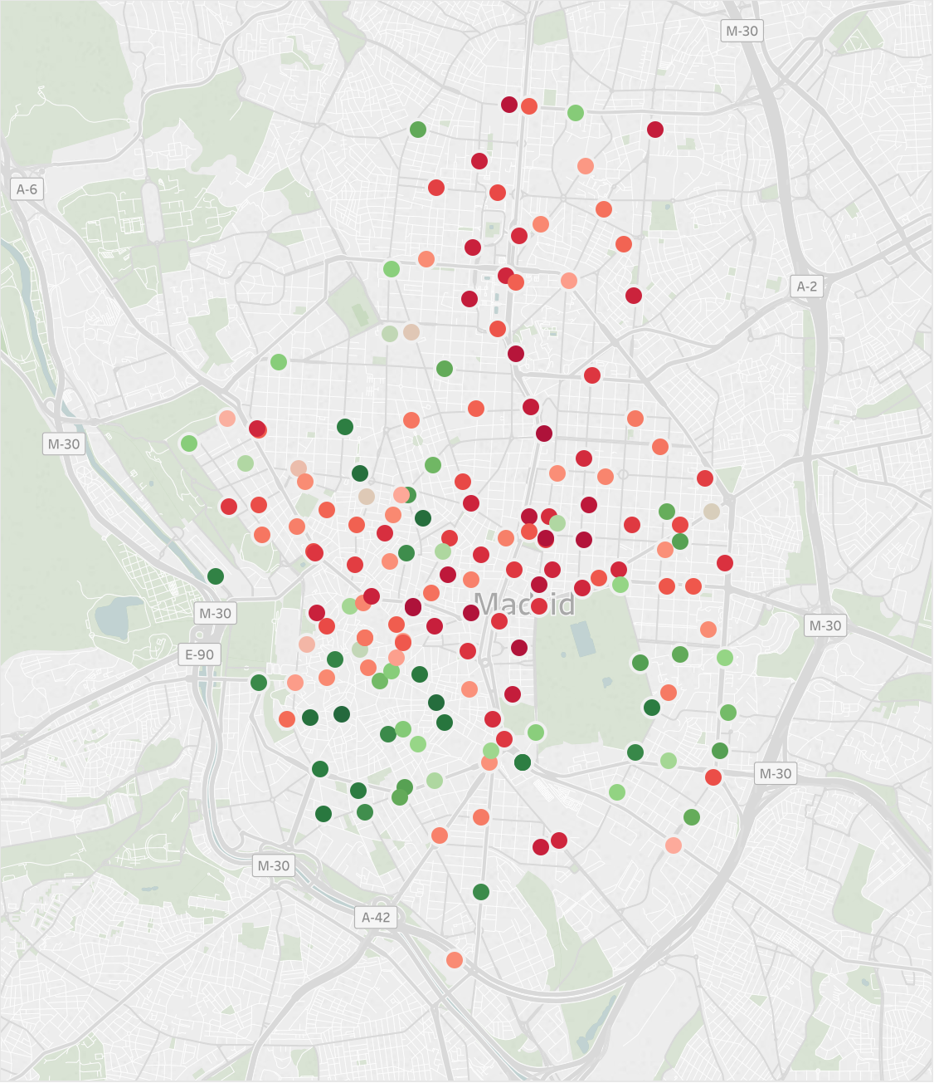
18:00 Tuesday

Slide 20
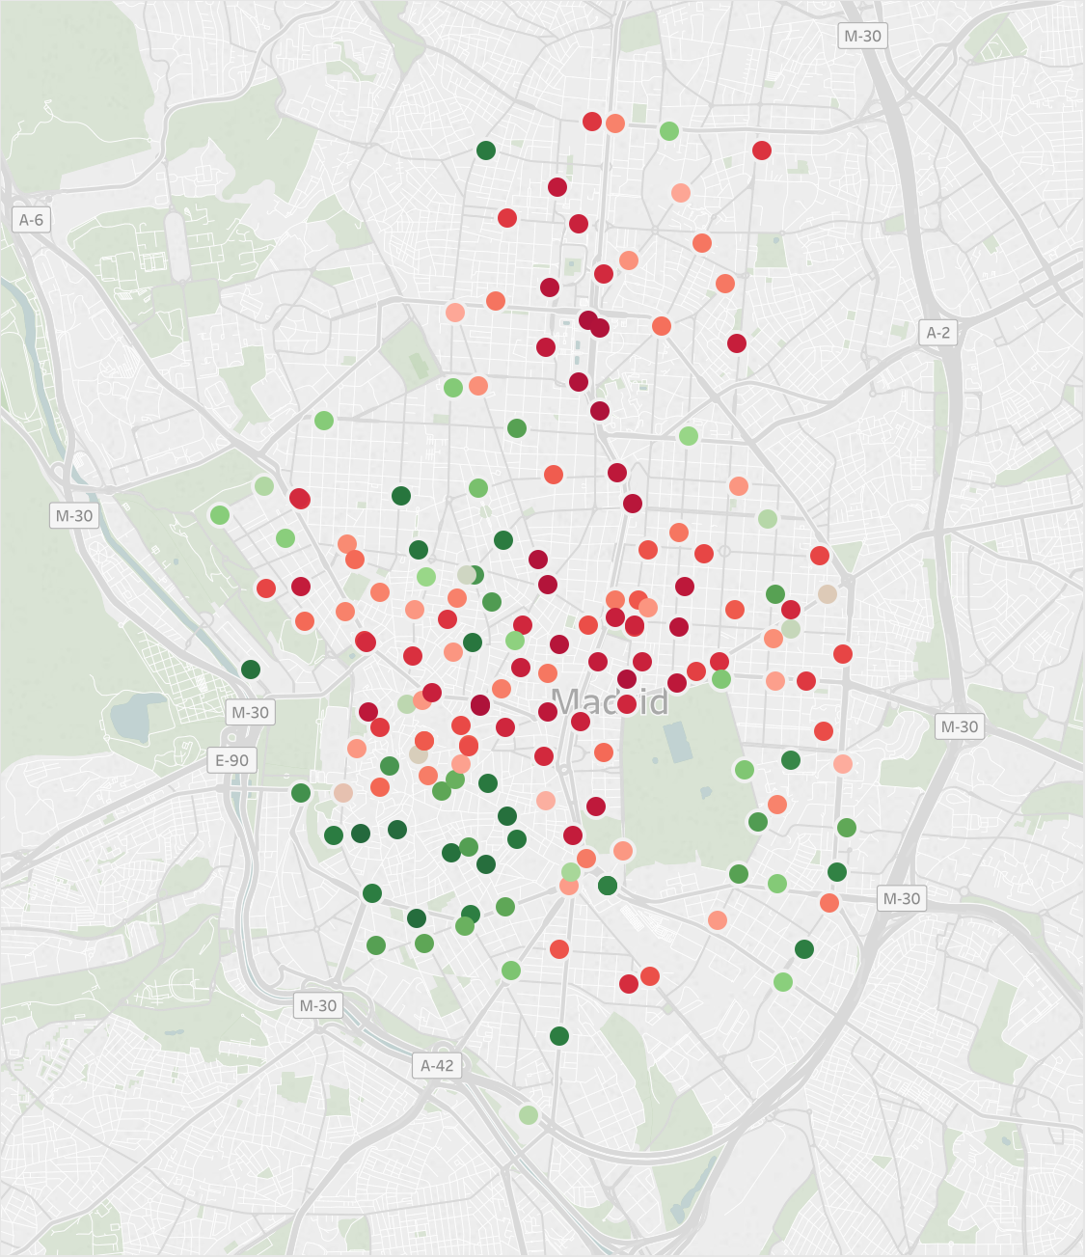
19:00 Tuesday

Slide 21
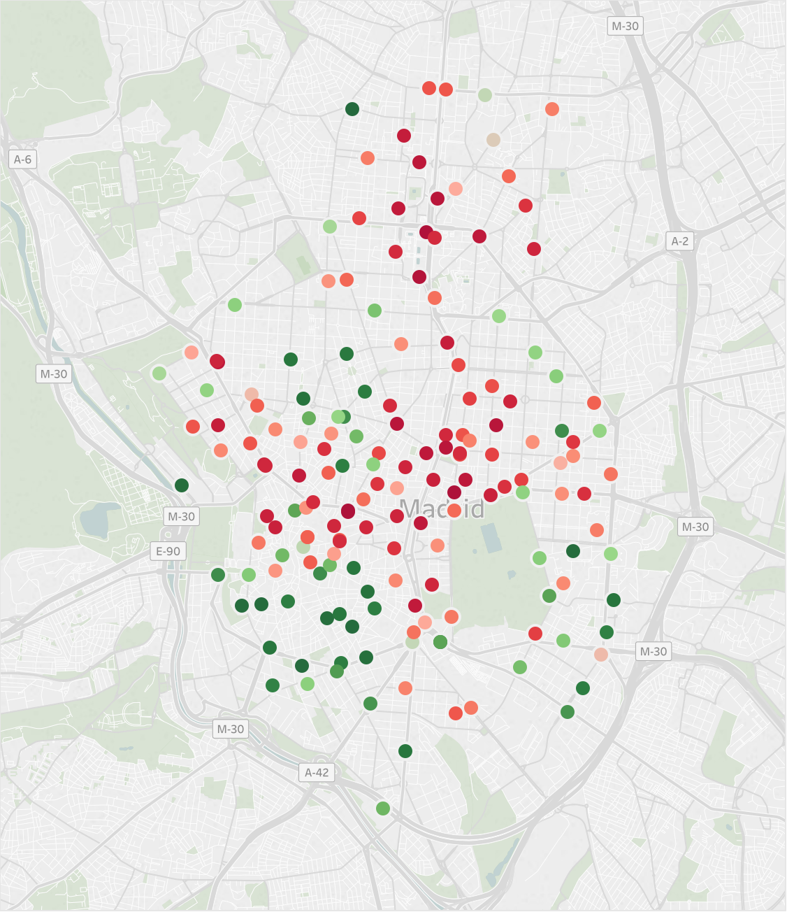
20:00 Tuesday

Slide 22
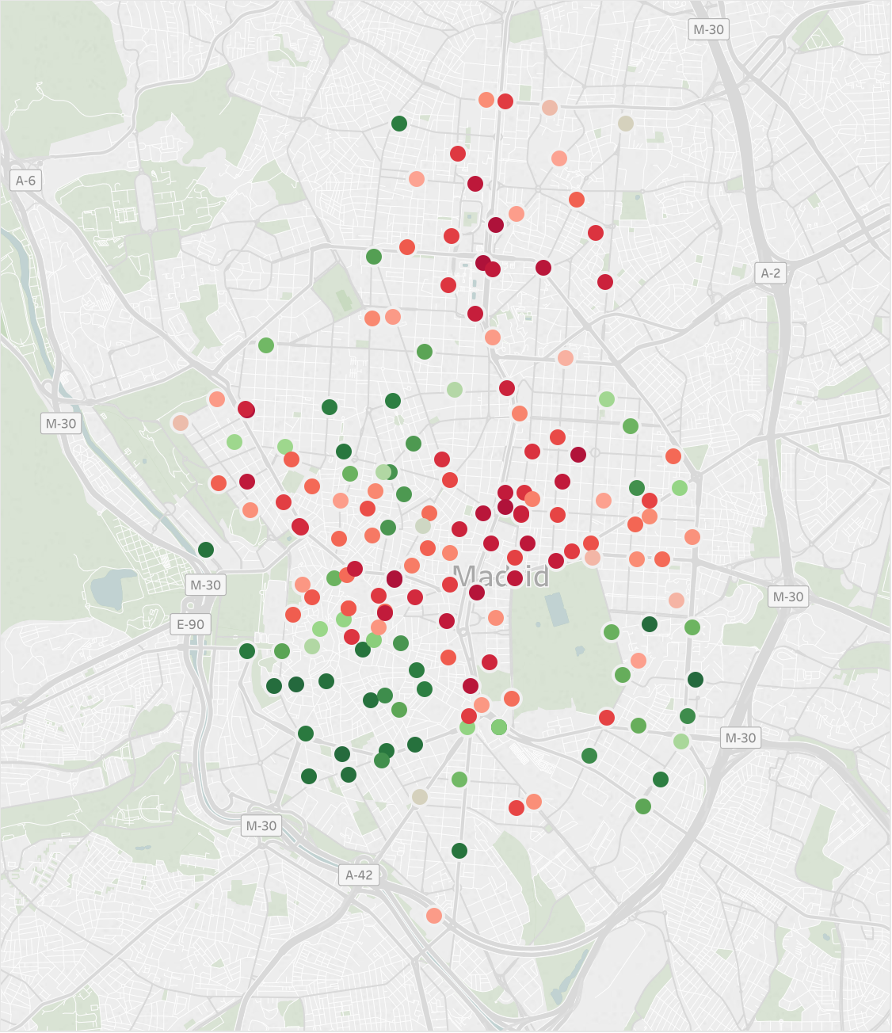
21:00 Tuesday

Slide 23

22:00 Tuesday

Slide 24
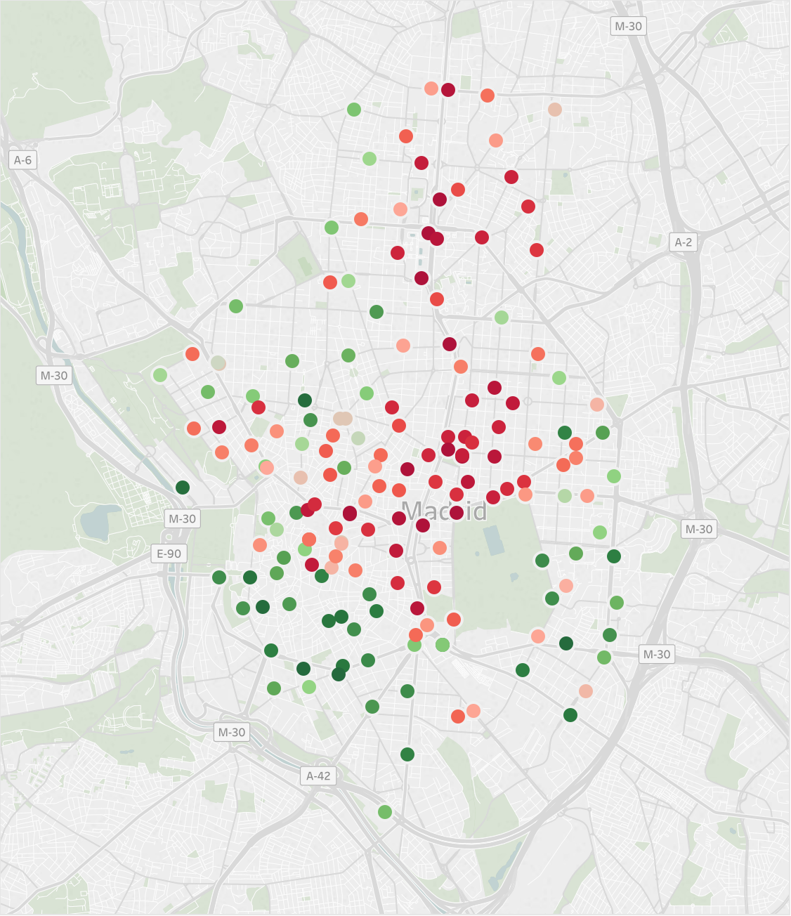
23:00 Tuesday

